Slide 1






Social Networking and you!
What it is and why we should care

Slide 2
A social definition
“Participatory” websites in which users generate content, share it, and make connections with other users.

Slide 3
What is Social Media?
Online content created by people
A shift in how people discover, read, and share news, information and content
Moving from monologue (one to many) to dialogue (many to many)
Changing people from content readers into contributors and publishers
Does not require expensive equipment or a government-granted license

Slide 4
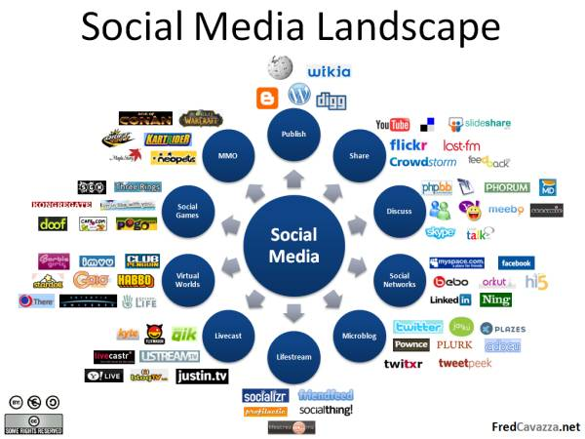
Notes:
Over

Slide 5
Social Media Growth
Domain expansion has leveled off…

Slide 6
Why Should We Care?
Twitter, social networks –(Facebook, Myspace), YouTube, Flickr, blogs, online communities (yahoo groups) | New ways to find information on parties, witnesses, friends and possible outside activities
Blogs, podcasts, RSS news feeds, social bookmarking, twitter | Tools for current awareness Tools to streamline online research and retrieval
Wiki, (Wikis are simple web pages that groups, friends, and families can edit together) Concept Maps, (A concept map is a diagram showing the relationships among concepts. It is a graphical tool for organizing and representing knowledge) Collaborative editing | Easier collaboration with teams, colleagues, experts. Access to info from anywhere with a connection.

Slide 7

Tonight’s Agenda
Video overview
Facebook
Twitter
My Space
LinkedIn
4 Square
You Tube (video)
Risks

Slide 8
Types of Social Media
Blogging
  A blog (or 10) for every subject
  Twitter (micro-blogging)
Social Networking
  Facebook, MySpace, Classmates, Friendster, Bebo, Orkut, Hi5
  LinkedIn, Plaxo, Xing, cofoundr, naymes
Bookmarking sites
  Del.icio.us, blogmarks, dogear
Photo / Video sites
  Flickr, Photobucket, YouTube
Virtual Reality
  Second Life, World Of Warcraft (WOW)
Groups
  Google, Yahoo!, etc.

Slide 9
Social Networks in Plain English
Examples:
  Myspace – high school students
  Facebook – college, adults
  Linkedin – professional networking
  Ning – private networks anyone can create
  Twitter – microblog, information regarding daily activities
  YouTube – video sharing

Slide 10

A video overview
This video does an outstanding job explaining the aspects of Social Networking in today’s society
SOCIAL MEDIA REVOLUTION

Slide 11
FACEBOOK
Where you spend time with people you know
Part blog / part community – much of what’s on your page is contributed by selected friends
You can play with apps and take & share surveys
A replacement for email
Professional networking – sharing what you’re doing and posting examples of what you’ve done
Businesses – fan sites where people to learn about the company, follow announcements and find links to the store site for orders

Slide 12
Check this out! – this kind of says it all
Facebook in real life!

Slide 13
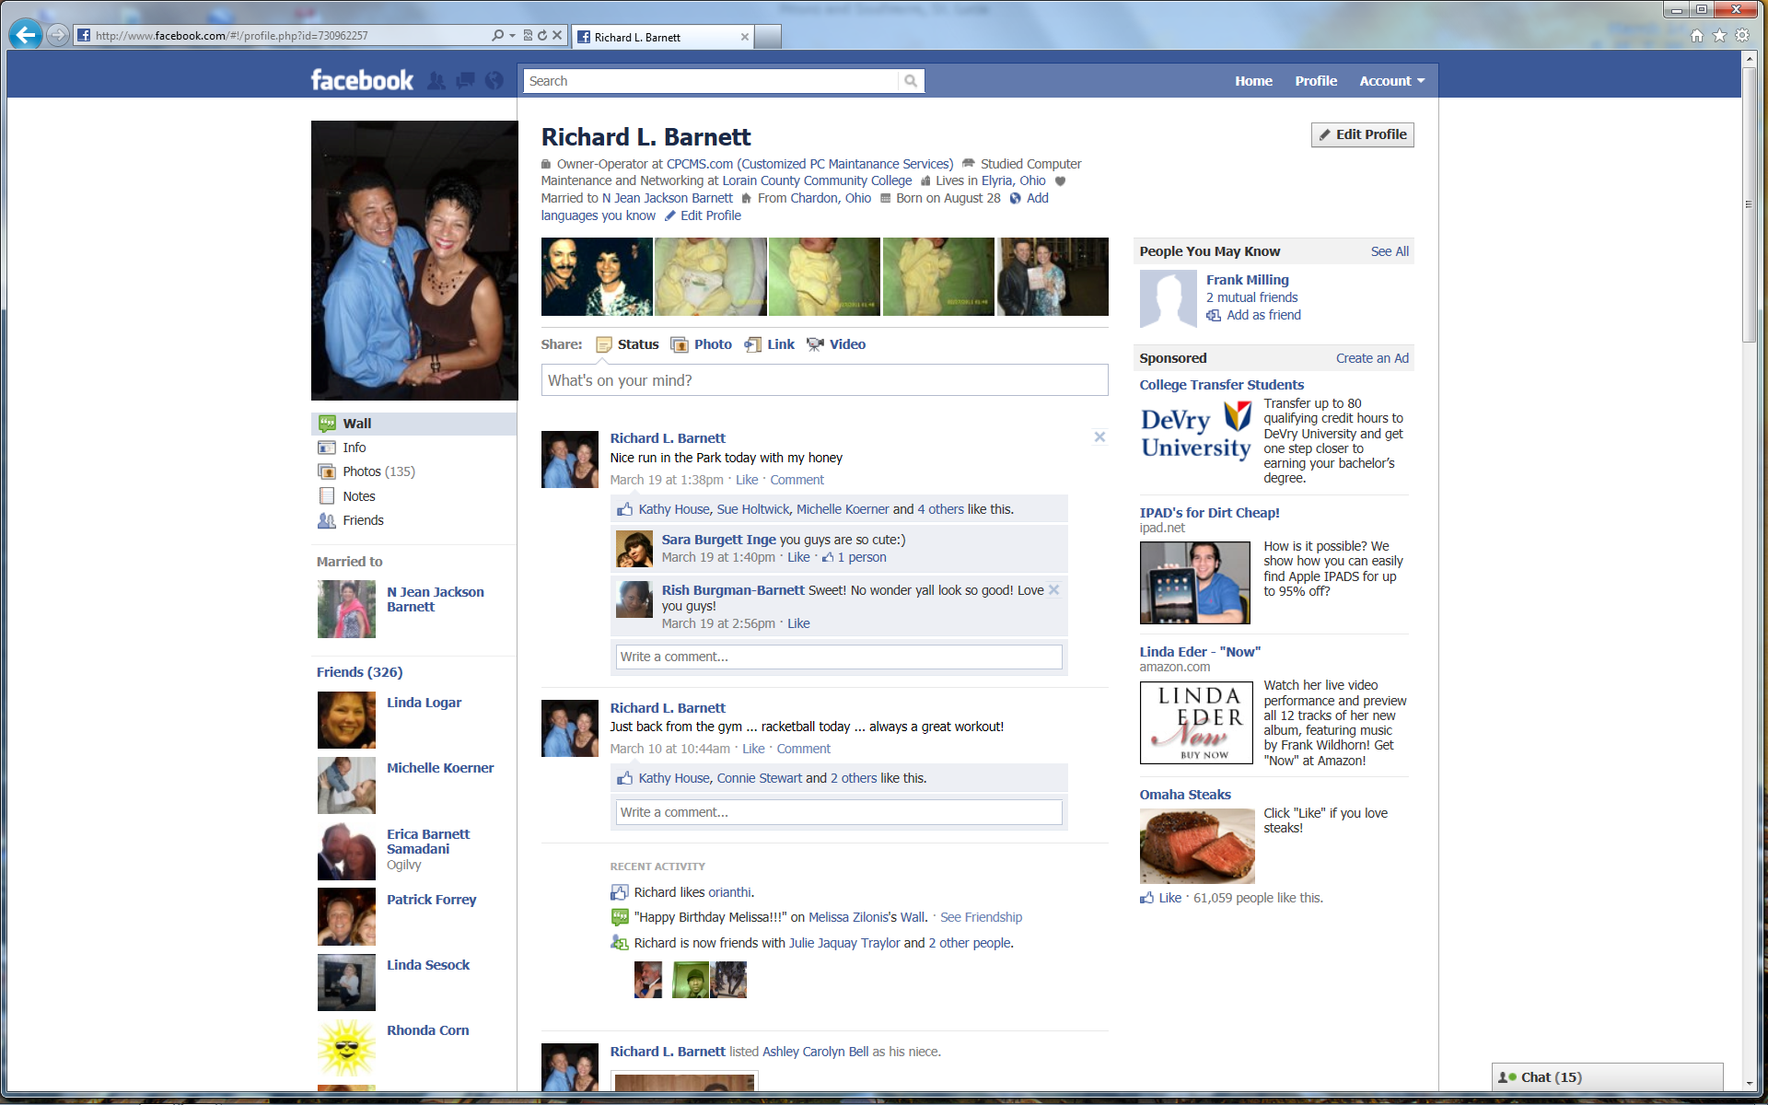
Guess who?

Slide 14
Linkedin
LinkedIn
LinkedIn is a business-oriented social networking site.
Founded in December 2002 and launched in May 2003, it is mainly used for professional networking

Slide 15
LinkedIn
LinkedIn -- launched in 2003
Used in over 200 countries
44 million members in the U.S.
56 million members outside of the U.S.
Total users - 100 million in (3/2011)

Slide 16
LinkedIn
It doesn't require a lot of personal time, because there is no requirement to join groups.
However in the beginning you have to look for people to join your network.
Once people have 35 or more connections, they seem to reach a tipping point where the usefulness of those connections becomes apparent.

Slide 17
LinkedIn
Make sure your profile is filled out. Don’t just give them a brief synopsis of your resume. Be detailed. Especially take advantage of that Summary! Fill it out and let people know what you can do. This is not the time to be shy!
Add your blog. LinkedIn has several apps that allow you to add your blog. Of course, this is assuming that you have something of value on your blog.
Add your Twitter stream. Let people see what you are tweeting about.
Join groups. And participate. Joining groups is useless if you don’t participate!

Slide 18
LinkedIn
Look for opportunities to respond to questions. Groups have Discussion sections for a reason – discuss!
Give testimonials. People like it when you give them a testimonial and they are likely to return the favor.
Research a company or person that you are interested in working with. Find out what they are all about and talk to them about what they are interested in.
Use SlideShare to add a presentation.
Ask intelligent questions.
Give away something free to your network – a report, e-book, or presentation.

Slide 19
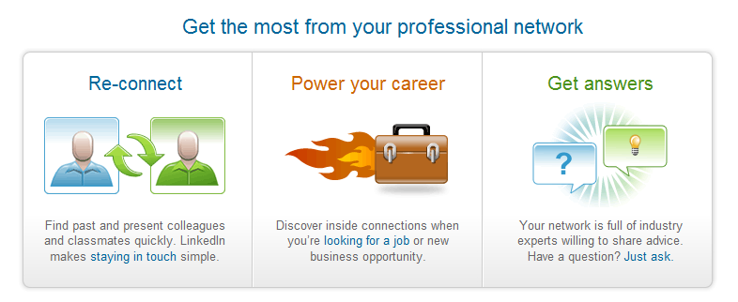
LinkedIn

Slide 20
LinkedIn
Over 100 million professionals now use LinkedIn to exchange information, ideas and opportunities.
http://www.linkedin.com/

Slide 21


Begun in March 21, 2006
At the heart of Twitter are small bursts of information called Tweets. Each Tweet is 140 characters in length.
A few Twitter facts (updated September 14, 2010)
  They have 175 million registered users.
  95M tweets are written per day.
  They have 300 employees and we're hiring.
  (In 2008, Twitter had eight employees; )

Slide 22

http://discover.twitter.com/

Slide 23
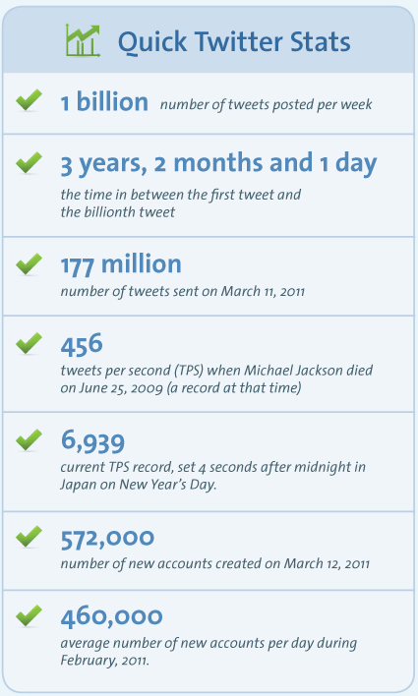

Slide 24
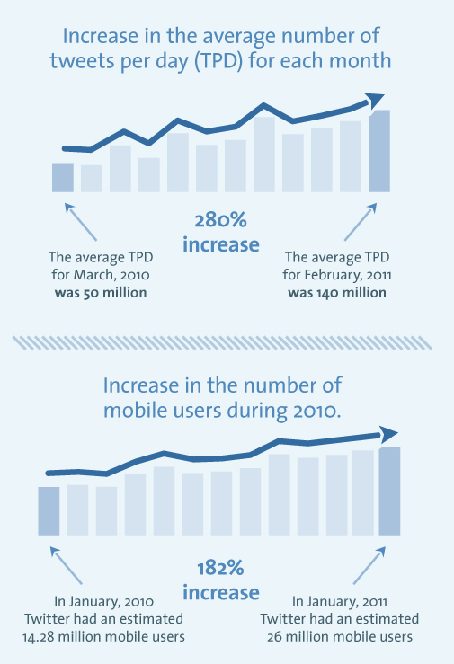

Slide 25
Example:
Here’s what I asked: “working on a twitter presentation for management – anyone want to share what you like about twitter?”
Within 20 minutes, I had received over 23 answers! Look at the interesting variety of answers:
amylibrarian - “keeping informed on technology and library issues”
digitalsista - “twitter is a resource on news and local grassroots activities”
pghgurl30 – “I like it cuz I can follow a variety of people easily, librarians, blogfriends”
Jill_HW – “Twitter = Instant support, feedback, solutions, etc.”
book_luvr – “I learn so much from all of you that I follow! I’m able to share with staff here.”
kenleyneufeld - “I find Twitter useful for professional networking.”

Slide 26
julian2 - “The conversation is very quick and enriched.”
jessewilkins – “more specifically crowdsourcing of links to resources.”
baldgeekinmd – “twitter can be quick and dirty, reach many easily”
bschu1022 – “The networking! I can get an answer to a question (in seconds!) from colleagues around the world & not just by email or phone!”
MyCreativeTeam – “twitter likes: follow/pitch journalists, query experts, gather blog fodder, promote blog via twitterfeed, quick friend contact”
sarchet62 – “I’m following as many health care providers I can find on twitter and learning learning learning helps in my work!!” and “if all you did was follow news channels the tweets are worth it”
coyenator – “connecting with people, cross-pollinating ideas, apps, experience, info, tools, innovations, and of course, opinions!”
znstrk – “quick responses when you ask a question, and interesting tweets from others.”

Slide 27
The Bare Bones Guide to Twitter
Highlights:
  Set up a SHORT Twitter handle.
  Use an application like TweetDeck (our choice), Hootsuite, Seesmic or a mobile client if you tweet from your phone.
  Tweet often. Tweet regularly.
  Make your own voice heard.
  Leave enough room for retweets.
  Test and shorten the links that you retweet. Don’t overfollow.
  Pithy facts go viral.
  The # symbol is called a hashtag. Hashtags designate that your tweet connects to a certain subject.
  Love the DM; fear the DM.
  Blog n’ Tweet. Tweet when you blog something new.
http://www.theatlantic.com/technology/archive/2011/03/the-bare-bones-guide-to-twitter/72283/
Mar 10 2011, The Atlantic

Slide 28

Uses
Ask for advice
Politics
Gage public opinion of a film – or…
Follow your favorite team.
helpful because it lets you rage to millions of
t's like a conference call with text messaging. –
arrange lunch
get quick answers
find a job
Microblogging
keeping up with the news
Etc., etc.

Slide 29

Websites, powered by broadband connections, became a lifeline for many of those in Japan.
Even the US State Department resorted to using Twitter
to publish emergency numbers, and informing Japanese
residents in America how to contact families back in
Asia.
For many, Twitter, the micro blogging site and Facebook, became the easiest, quickest and most reliable way for the survivors to keep in touch with relatives
as well as providing emergency numbers and information to those in stricken areas.

Slide 30

Department of Homeland Security could start using social networking channels such as Facebook and Twitter to alert the public of changes in the nation's threat level, the Associated Press reported.
British government is seeking to hire someone to boost its online presence, after advertising for the post of an ‘Executive Director Digital’ on the Civil Service jobs website being called a Twitter Czar.
On Facebook and Twitter, spreading revolution in Syria.
Social networks are playing a central role in fueling protests in Syria, where demonstrations Friday were the largest since anti-Assad activists took to the street last month.

Slide 31

“This is what the naysayers fail to understand:
it's just as easy to use Twitter to spread the word about a brilliant 10,000-word New Yorker article as it is to spread the word about your Lucky Charms habit.”
–Steven Johnson, author of The Invention of Air

Slide 32

For More information on Twitter
http://support.twitter.com/groups/31-twitter-basics Twitter Basics – mini tutorials
http://discover.twitter.com/
http://laughingsquid.com/twitter-in-plain-english-a-how-to-tutorial-for-twitter/
http://www.wikihow.com/Use-Twitter How to use twitter
http://news.cnet.com/newbies-guide-to-twitter/ newbies guide

Slide 33

What Is MySpace?
Web site that showcases new bands and musicians
“Online social networking” service
Site where people can interact with each other
Place where people can create their own Web pages
Notes:
MySpace was started as a Web site to showcase new and upcoming bands and musicians
Currently one of the most popular “online social networking” Web sites
One of the hottest sites for people to share information and interests and interact with each other; allows users to connect with friends and meet new people
A place where people can create their own Web pages displaying their personality, interests, and hobbies

Slide 34

What Is MySpace Used For?
Expressing yourself
Keeping in touch with friends
Meeting new people
Browsing endless information
Posting school activities
Notes:
You can create a personal Web page that displays your hobbies, favorite movies and TV shows, favorite books, heroes, and more. You can also keep a blog (online diary).
You can keep in touch with your friends through e-mail and instant messaging. You can post comments on friends’ profiles. You can also find and reconnect with old friends.
You can meet new people outside of your local community. MySpace gives you the opportunity to connect with people all over the world. You can find new friends who share the same interests.
You can browse endless information and discover new ideas. You can research new hobbies and interests.
MySpace can also be used to plan and post school activities

Slide 35

Who Uses MySpace?
People who want to browse, learn, and meet new people
Anyone who can use a computer can use MySpace
22% of users are under 18
Popular with middle and high school students
Over 60 million members
Notes:
Although it is still used by bands and musicians, the majority of MySpace users are there to browse, learn, and meet new people
Anyone who can use a computer can access the Web site and obtain a MySpace account. MySpace is absolutely free for all users.
Although anyone can use MySpace, 22% of registered users are under the age of 18
MySpace is very popular with middle and high school students
Currently, there are more than 60 million MySpace members

Slide 36
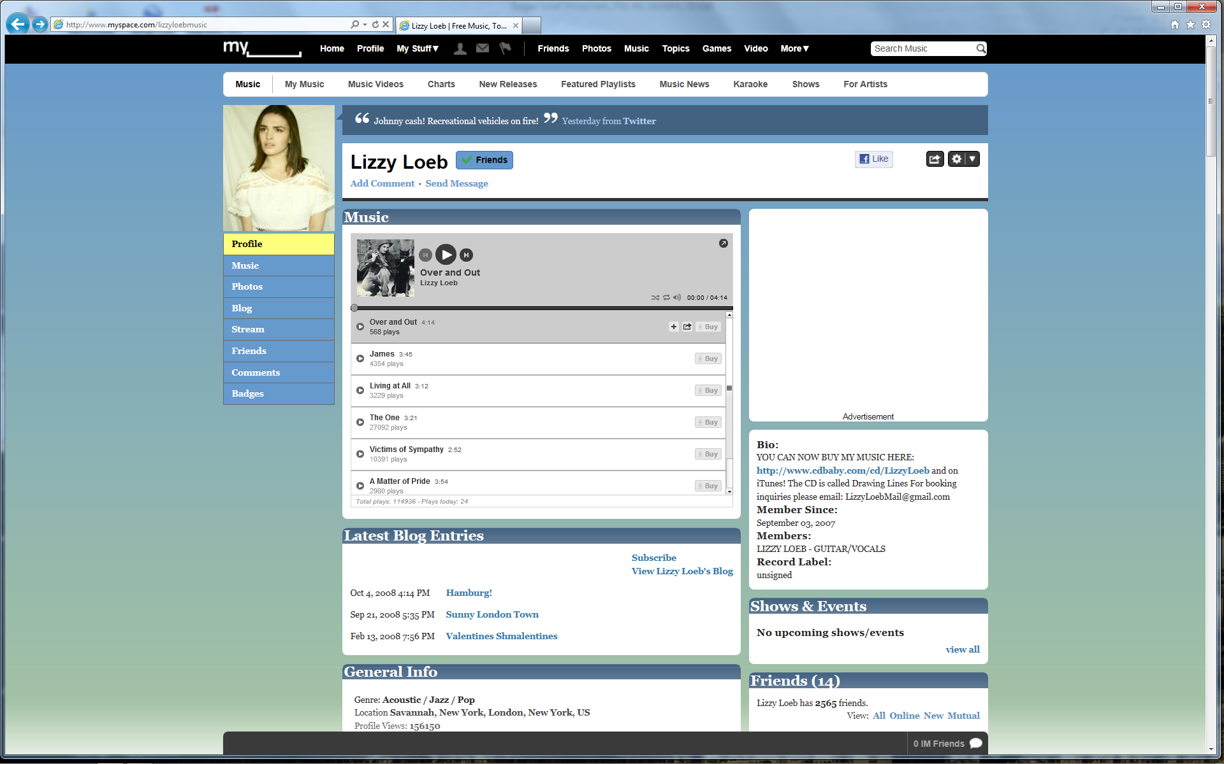
Typical Myspace page

Slide 37


WHAT IS FOURSQUARE?
Location-based social media
3 Million Users
Started for individuals
A ‘game’ for earning points, prize badges, mayorships, coupons, etc.
Geo-marketing tool for businesses and brands
  Coke
  Harvard
  – The North Face, Gap,
  Bravo/Sephora
Connects other social outlets

Slide 38
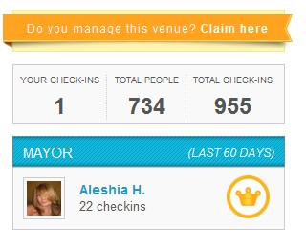
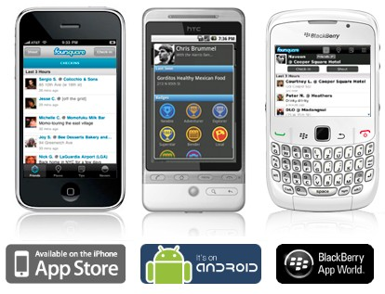
How DO I FOURSQUARE?
Create Account at www.foursquare.com
Find Friends
Download App
Check In, Share Tips, Eat Free Pizza

Slide 39
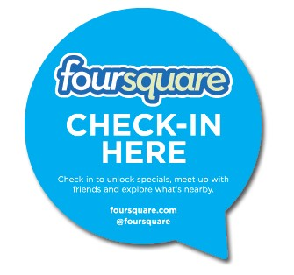
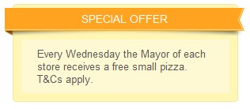
WHY FOURSQUARE?
Leveraging Foursquare as a Business
Claim Your Location
Set up Standard Account or obtain Brand Account
Get your customers to share and interact with
your business
Honor them. Checkins are the new discount ‘coupons’
1 User check in = 1000’s
Partnership. Custom Badges
Announce on other Social Channels
Build your Brand presence
Don’t allow employees to check in
Use the Foursquare Specials Feature
Leverage Analytics

Slide 40
A video sharing web site owned by Google. Since it is video, let’s let it explain itself.

Slide 41


Risks??
Risks associated with social media

Slide 42


Types of Threats
Users
publishing information
Social
networking
attacks
Two main types of threat
Notes:
Generally the threats can be split into two camps
Information volunteered by users – either deliberately or inadvertently
Social networking attacks
Let’s now look at these two aspects in more detail

Slide 43
Users Publishing information
Reveal sensitive information
Defamation of others/school system
This can be inadvertent or deliberate
And the repercussions include:
Reputation damage
Fines
Users publishing information
Notes:
The first type of threat, information from users, is by far the simpler – because it’s all about an individual’s direct actions.
Revealing sensitive information on a social networking site is a big threat. Examples of the type of information include
- confidential sales figures – which are gold dust to the competition
- negative comments about colleagues – which can be intimidating and bullying
- industry secrets – which destroy the organisation’s competitive advantage
- personally identifiable information on customers – which has data protection implications
This information can be made public both deliberately – such as a revenge attack – or, most commonly, inadvertently. Often lax privacy settings mean that when you think you’re sharing information with just a select group of people it is actually visible to wider groups, including complete strangers.
By their nature social networking sites want to encourage sharing and openness, and this is reflected in the default settings . However from a security perspective, this is a dangerous approach and opens up a huge security hole.
The end result can be damaged reputations – both for the individual and their organisation. It can also be wider damage to the organisation such as through lost business, or fines from regulators.

Slide 44



Attacks!!
Hobby/
showing off
Financially-motivated
organized crime
Social networking attacks
Notes:
The other element, social networking attacks, is much more complex as it’s now become real big business. We’re going to spend a bit of time looking at the motivation for these attacks and how they work in practice.
Back in the days when computers were in their infancy, most hackers just wanted to show off skill and knowledge.
Cybercrime has now evolved into organised criminal activity, with the lure of large amounts of money. A whole economy has sprung up around the abuse of other people’s computers and their data.
And as the digital generation continues to embrace social media for personal and work or study purposes, so hackers are targeted social networking sites with their financially-motivated attacks.
When personal glory was the goal, attacks were invariably highly visible so the hackers could show-off their achievements. However now that the main motivation is financial the threats are often silent and hidden – the hackers don’t want you to find out as this would hamper their activities.

Slide 45

How they attack
Social networking attacks
Social networking accounts
are valuable to hackers
They can use them to send spam,
spread malware, steal identities...
… in the quest to acquire personal
information for financial gain
Notes:
Social networking accounts are valuable to hackers
They can use them to send spam, spread malware, steal identities..
… and their end goal is usually to steal data in order to make money

Slide 46
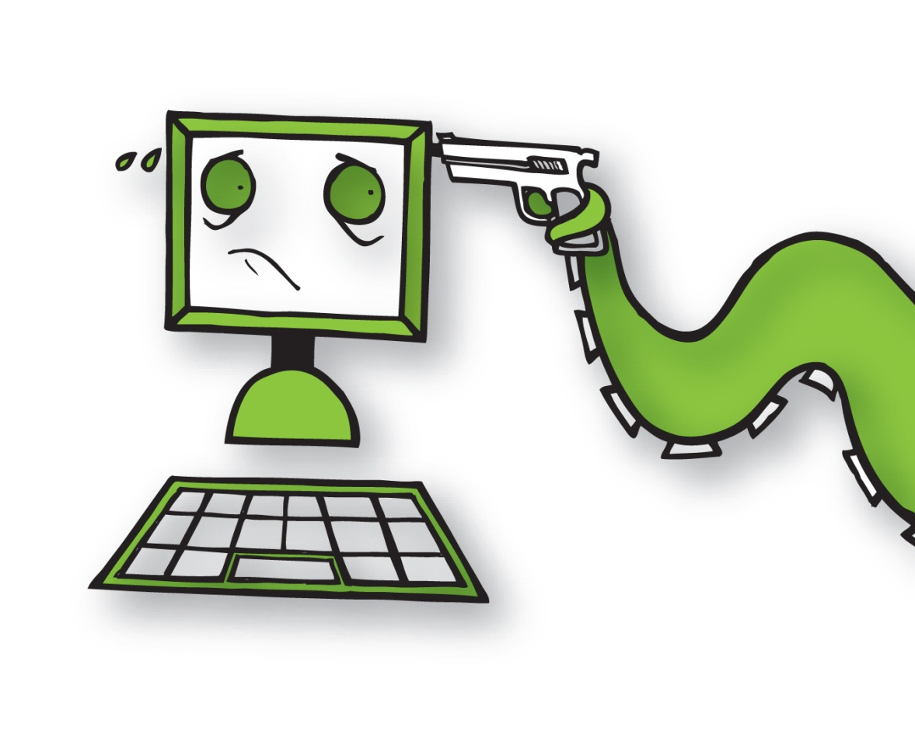
Data
Steal your money directly
Sell your data
Trick your friends and family into
supplying personal data
Sell your identity
Use your accounts to spread spam,
malware and more data theft scams!
Sell your school’s data or
sensitive information
Blackmail individuals and organizations
Data = $$$
Notes:
The end-goal for most hackers is to get personal data. Because personal data = money.
Once they’ve got the data there are many ways criminals can use it to make money. For example, they can:
Steal your money directly e.g. use your details to access your bank accounts or purchase items using your funds
Sell your data so others can steal your money (as previous)
Trick your friends and family into supplying personal data in order to steal their money e.g. the criminals pretend that they are you and get those close to you to hand over sensitive information like their bank account details.
Sell your identity so other criminals can pretend to be you – and then incur financial and legal liabilities in your name.
Use your accounts to spread spam, malware and more data theft scams!
Sell your organisation’s data or sensitive information
Blackmail individuals and organisations – this is particularly pertinent for organisations when customer lists or industry secrets can be held to ransom

Slide 47
Top tips for staying secure
KNOW THE RULES - check your organization’s policy on social networking
USE SECURE PASSWORDS - minimum 14 characters including non-letters
CHECK THE DEFAULT SETTINGS - don’t providing personal information
by default
BE PICTURE PRUDENT - think before posting images that might cause embarrassment
BEWARE OF BIG BROTHER - assume everyone can read your posts, including hackers!
SECURE YOUR COMPUTERS - use up-to-date security software and firewalls
THINK BEFORE YOU CLICK - if the email looks dodgy it probably is
STRANGER DANGER - beware of unsolicited invitations from spammers
Notes:
We’ve seen the risks from social media and how then work. Now let’s turn our attention to how to use social media safely.
You don’t have to stop using it! The important thing to remember is to follow these simple safety guidelines so you and your organisation stay secure.
KNOW THE RULES - check your organisation’s policy on social networking. Make sure you stick within your organisation’s rule
USE SECURE PASSWORDS - minimum 14 characters including non-letters. The onus is on you to ensure the hackers can’t crack your passwords and access all the valuable information they hide.
CHECK THE DEFAULT SETTINGS - don’t providing personal information by default. By their nature social networking social networking sites want to encourage sharing and interaction, so often the default settings leave you open to strangers accessing your information. Make sure you check the defaults and where necessary update yours to make them more secure.
BE PICTURE PRUDENT - think before posting images that might cause embarrassment to either you or your organisation. Although the photo might be funny, do you really want everyone to see it!
BEWARE OF BIG BROTHER - assume everyone can read your posts, including hackers! Always play safe and work on the assumption that your posts are not secure, so only share information you are happy to be in the public sphere.
SECURE YOUR COMPUTERS - use up-to-date security software and firewalls. Malware is a serious threat through social media and it’s essential to make sure any computer you use is protected against viruses, Trojans and other malware threats.
THINK BEFORE YOU CLICK - if the email looks dodgy it probably is. Resist the urge to automatically click on a link. Check before you click – does it look legitimate, is it realistic that the person who appears to have sent it really did.
STRANGER DANGER - beware of unsolicited invitations from spammers. Responding to a spam email confirms to the spammer that your email address is live, and therefore can be sold on to other cyber criminals. If you are unsure about the sender, think before you click or respond.

Slide 48
And so…
One more time …

Slide 49
Questions and member interaction
Let’s chat about this LOL ☺

